Slide 1
Trade Associations and Talent Development
Wendy Brors
Colorado Workforce Development Council

Slide 2
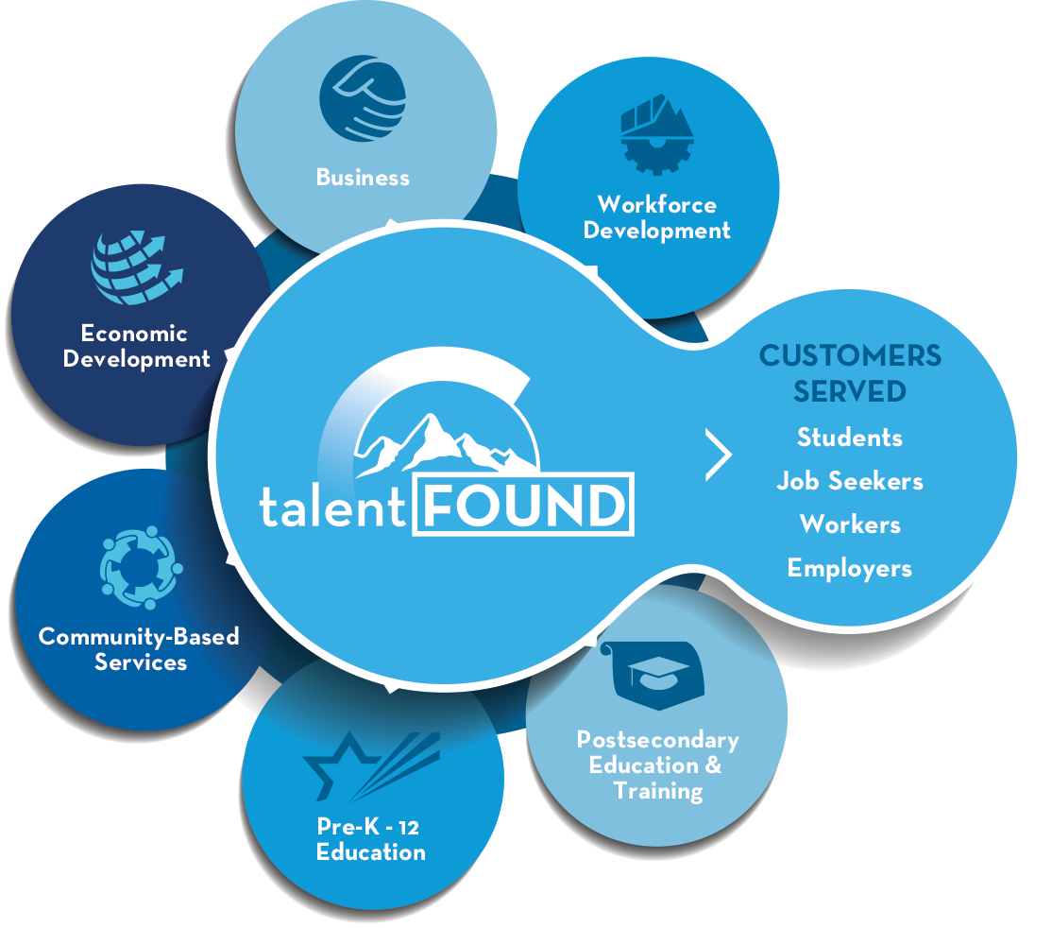
Talent Development Network
Notes:
Vision - Every Colorado business has access to a skilled workforce and every Coloradan has access to meaningful employment, resulting in statewide economic vitality.
Mission - To facilitate the creation and sustainability of a industry-led Colorado talent development system that appropriately integrates the work of education, training, economic and workforce development to meet the needs of businesses, workers, job-seekers and students.

Slide 3
Talent Development Strategies
Have it in your mission or goals
Know your talent development system
Work collectively with trade associations from other industries
Foster industry-leadership
  Have a talent committee and expand their expertise
  Ensure member businesses support workforce development boards, academic advisory councils
  Convene sector partnerships if they don’t yet exist
Notes:
Intermediaries have a very important role.

Slide 4
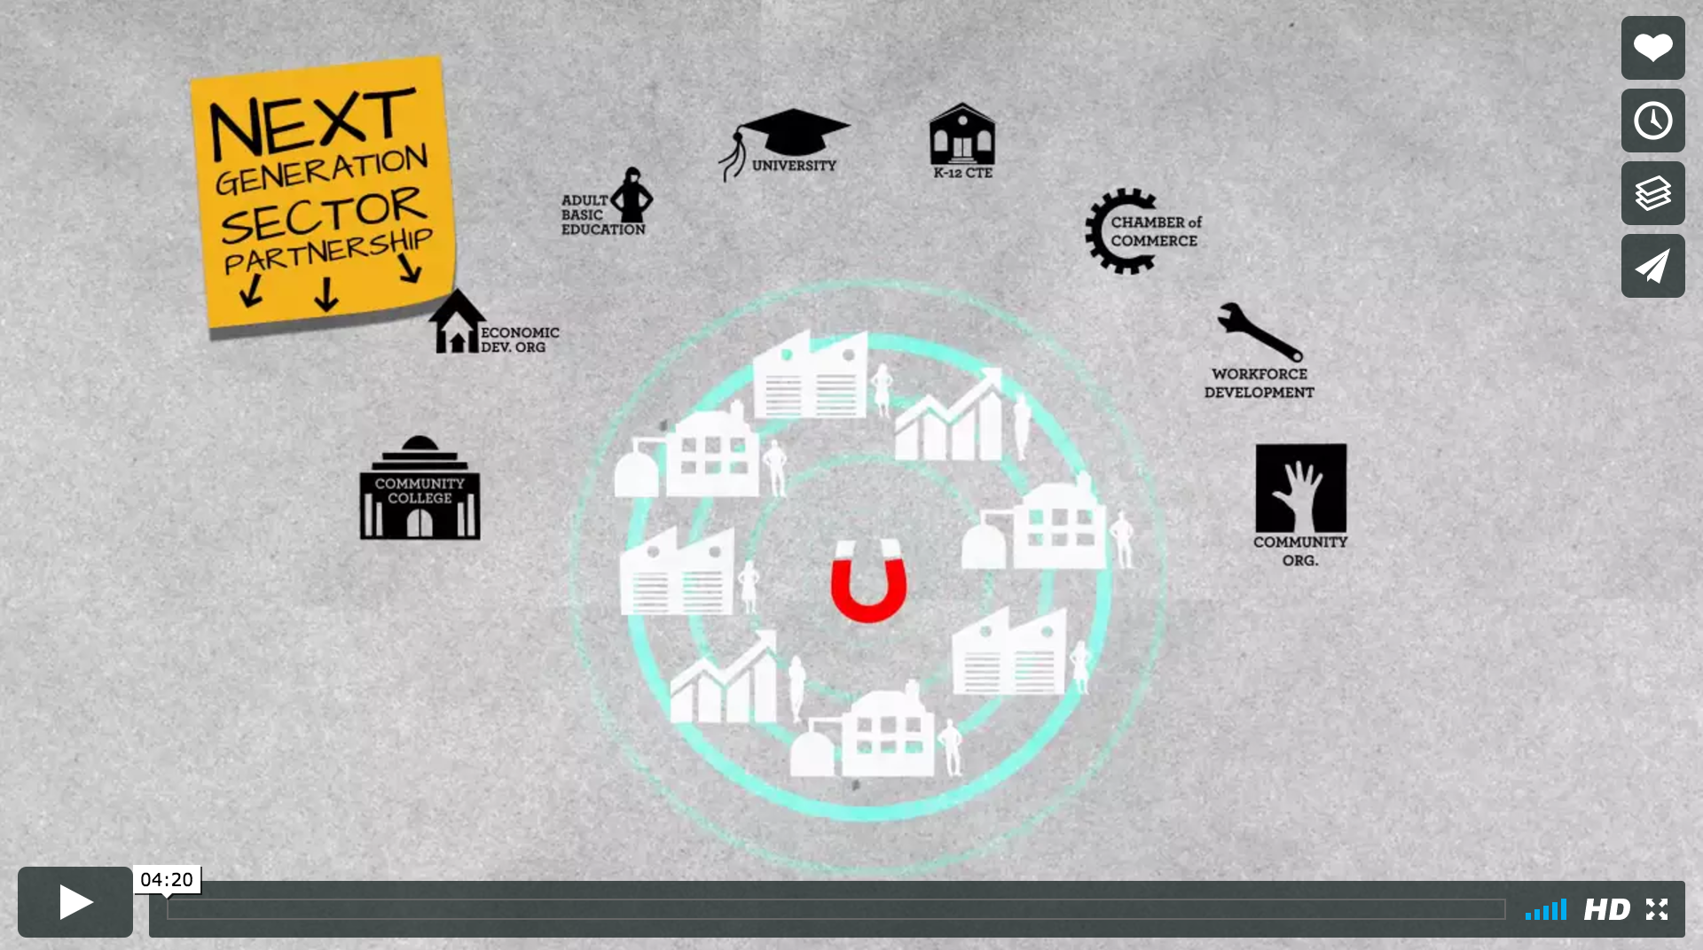
Sector Partnerships
Notes:
https://vimeo.com/204036933

Slide 5
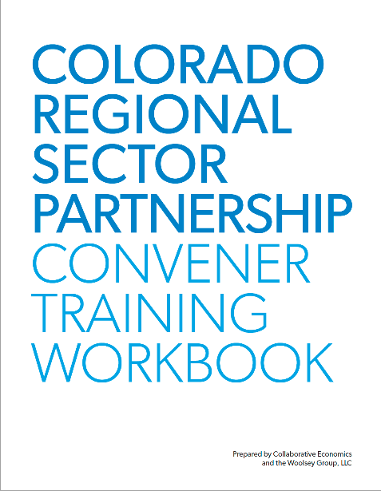
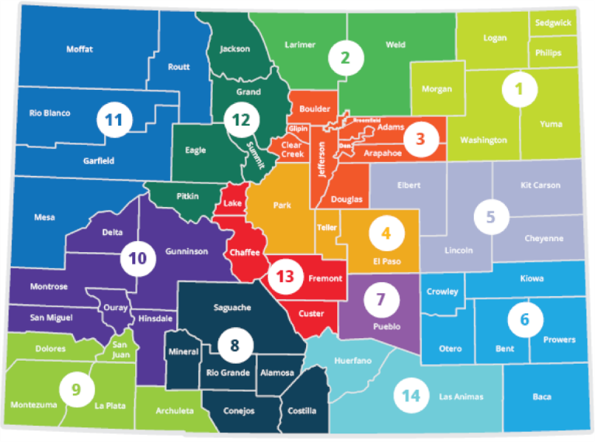
Sector Partnerships
R1 Northeastern Colorado Manufacturing
R2 NOCO Health Sector Partnership
R2 NOCO Manufacturing
R3 Metro Denver Retail
R3 Tree Care (Arborist)
R3 Greater Metro Denver Healthcare
R3 Metro Denver Construction
R3 Metro Denver IT
R3 Metro Denver Manufacturing
R4 COS Health
R4 CAMA South
R5 Health & Wellness
R6 Southeastern Colorado Healthcare
R6 Southeast Colorado Manufacturing
R7 Southern Colorado Healthcare
R7 Southern Colorado Manufacturing
R8 SLV Value-Added Ag
R8 SLV Health and Wellness
R9 Southwest Colorado Healthcare
R11 Mesa County Health Care
R11 Mesa Manufacturing
R13 Upper Arkansas Healthcare
R13 Upper Arkansas Outdoor Recreation & Tourism
Notes:
There are many places that industry-led workforce development initiatives and programs are being worked on today. If you want to sit at the table with other businesses to help set the workforce development agenda, you could consider joining the following efforts:
Regional Sector Partnerships
Trade Associations
Workforce Development Boards
Academic Advisory Councils
Economic Development Boards
Non-profit community organizations
For-profit businesses
The Colorado Workforce Development Council has been nurturing the development of regional sector partnership for the past 4 years. A sector partnership is an industry specific regional partnership led by business in partnership with economic development, education, and workforce development. Over 450 businesses are actively involved in 20+ sector partnerships across all 14 economic regions of Colorado today.

Slide 6
Positive Regional Impacts
82%
developed new or enhanced ideas for new products and/or markets
91%
found support in finding employees with the skills and experiences relevant to their business needs
82%
developed new recruitment practices
71%
increased student/jobseeker awareness of training/education programs.
62%
experienced increased alignment across secondary, post-secondary, and workforce programming.
67%
enhanced existing or developed new training/education program(s).
On Businesses
On Jobseekers and Students
Notes:
Positive impacts from sector partnerships

Slide 7
Talent Development Programs
Identify existing critical career pathway programs and broker businesses to them
Inform and influence businesses to establish a talent pipeline strategy that results in them expanding work-based learning opportunities
Lead or ensure occupation / career competencies (knowledge, skills and abilities) are defined and distributed locally
Notes:
Career Pathways Systems Building (Edu & Training Programs)
If you are interested in learning more about whether or not quality career pathway programs exist to develop the talent you need, you may want to consider learning more about existing career pathway programs.
What is a career pathway system? A career pathway system aligns public partners and engages them in a continuous conversation that is led by industry to ensure that job-seekers and students move seamlessly through and among support programs, educational institutions, training opportunities, and work-based experiences to build skills and credentials that meet industry demand and prepare them for jobs and careers. In Colorado, a sector partnership is the vehicle for building industry-driven career pathway systems, providing a forum for productive and ongoing collaboration with industry and among workforce, education, training partners, and other community partners. In Colorado, the statewide career pathway system aligns career pathway programs and systems developed throughout high demand industries in each economic development region of the state.
What’s the difference between a career pathway system and a career pathway program? A career pathway program offers a clear sequence of stackable credits and credentials, combined with support services, which enables students and job-seekers to secure industry-relevant skills, certifications, and credentials and advance to higher levels of education and employment in high demand occupations. A career pathway system is made up of multiple career pathway programs that span educational institutions, workforce and support service partners. These programs are all oriented around a shared understanding of the needs of industry. Often times, tools like career pathway maps are used to talk with students and job seekers about how they can progress through education and training experiences to obtain employment that meets his or her goals.

Slide 8

WORK-BASED LEARNING CONTINUUM
Career Awareness
LEARNING ABOUT WORK
Career Awareness experiences are those that help students build awareness of the variety of careers available.
Career Presentations
Worksite Tours
Career Fairs
Career Exploration
LEARNING FOR WORK
Career Exploration provides students with short term direct interaction with partners and the opportunity to explore career options in a way that contributes to motivation for learning and informs students’ decisions about further experiences and educational options.
Job Shadow
Mentoring
Career Counseling and Planning
Work-based problems with classroom mentoring
Career Preparation
LEARNING THROUGH WORK
Career Preparation experiences support college and career readiness and include extended direct interaction with professionals from industry and the community. These experiences are designed to give students supervised practical application of skills and knowledge and often occur in CTE courses.
Clinical Experiences
Internships
Extended Learning
Instructional Worksite Learning
Career Training and Education
LEARNING AT WORK
Career Training experiences prepare students for employment in a specific range of occupations.
On-the-Job Training
Youth Apprenticeship (occupation focused)
Pre-Apprenticeship
Adult Registered Apprenticeship (job focused)
Adapted from Washington STEM: http://www.washingtonstem.org/STEM/media/Media/Our%20Impact/CCL-Continuum.pdf
Notes:
The portfolio of talent development programs that require business leadership and ownership we’re referring to as work-based learning
WBL programs require
Labor market data
Competency maps (defined in the context of work scenarios)
Continuum of experiential learning programs to attract and develop talent

Slide 9
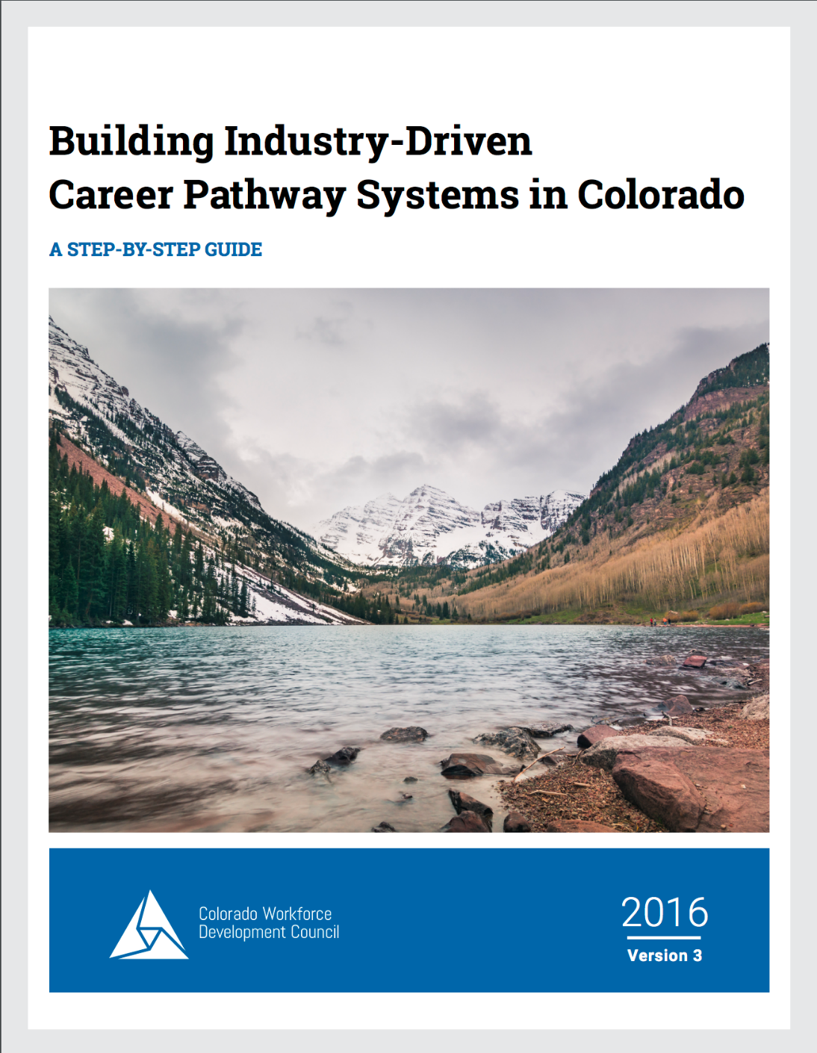
Career Pathways for Critical Occupations
Gather labor market data
Identify “critical” jobs
Identify competencies (knowledge, skills and abilities)
Identify existing career pathway programs
Promote
Work to build or enhance career pathway programs as needed
Notes:
Competency-Based Approach
Compile KSA (see O*Net)
Vet locally for critical occupations
Distribute to educators and trainers

Slide 10
Colorado’s Construction Top Jobs Map
Building & infrastructure with Skilled Trades
Pre-construction & Professional
Superintendent
Foreman
Architect
Engineering Instructor, Postsecondary
Skilled Trades Professional/Journeyman/Technician, including:
Brickmason & Blockmason Plumbers
Pipefitter & Steamfitter Firesprinkler Fitters
Heating, Air Conditioning, & Refrigeration Mechanics & Installers
Security & Fire Alarm Systems Installers
Glazier Electrician
Sheet Metal Worker
Tile & Marble Setter
Carpenter Pipelayer
Drywall & Ceiling Tile Installer
Cement Mason & Concrete Finisher
Roofer Painter
Insulation Worker
Structural Iron & Steel Worker
Cost Estimator
Electrical Engineer
Real Estate Appraiser & Assessor
Environmental Engineer
Operating Engineer & Equipment Operator
Interior Designer
Mechanical Engineer
Heavy Truck Driver
Civil Engineer
Construction Laborer, Apprentice, Assistant
Construction Laborers
Civil Engineering Technician

Slide 11

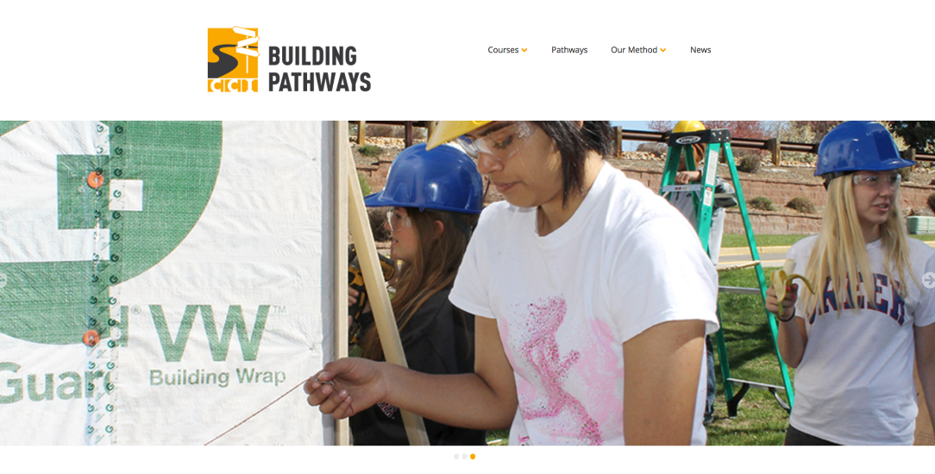

Promote Career Pathways

Slide 12




Employers Offer
Internships
On-the-job training (OJT)
Apprenticeships
Short timeframe and limited training and skill development
Historically focused on “white collar” jobs
Typically from Post-secondary
Paid, unpaid, or volunteer
Occurs during existing employment to enhance skills
Focused only on skills required for existing employer
Lacks classroom training
Longer timeframe and significant opportunity for skill development
Includes both OJT and classroom instruction
Paid opportunity: “earn while you learn”
Historically focused on trade jobs

Slide 13
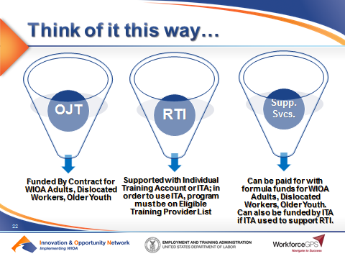
Workforce Funding

Slide 14
Talent development is more successful when it is
industry-led
and competency-based

Slide 15
Thank You!
wendy.brors@state.co.us
www.colorado.gov/pacific/cwdc
nextgensectorpartnerships.com
careersincolorado.org

