Slide 1
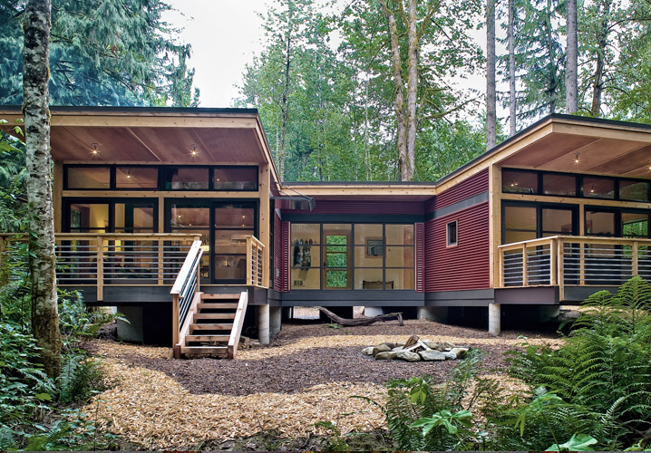
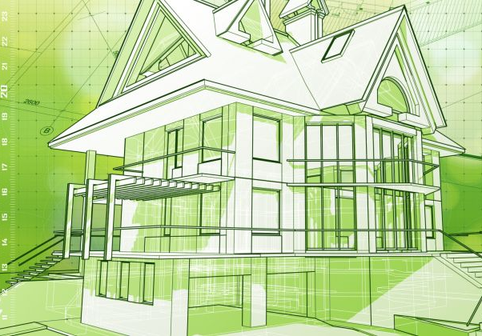
Sustainable Energy & Building

Slide 2
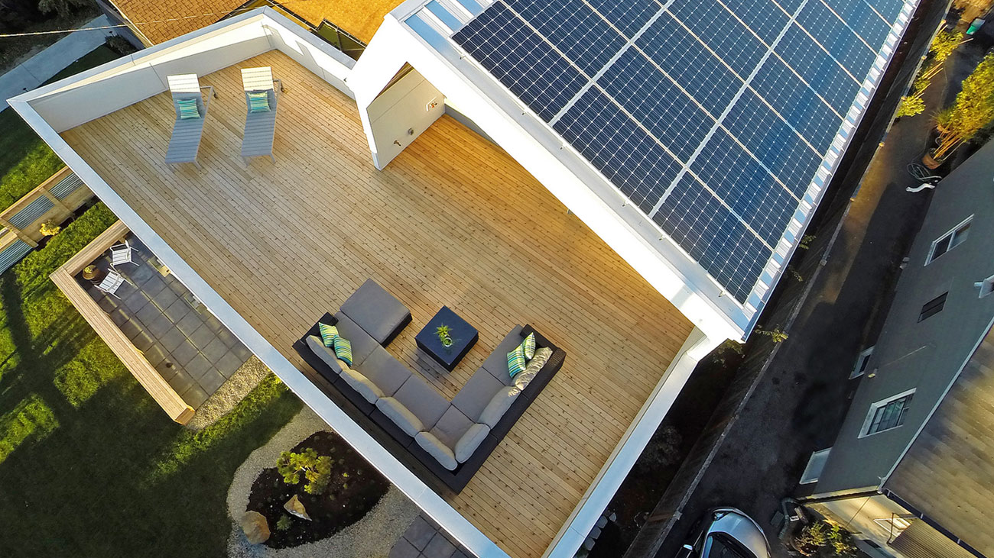
Introduction

Slide 3
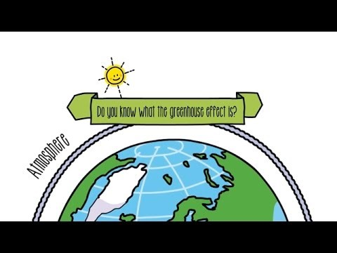
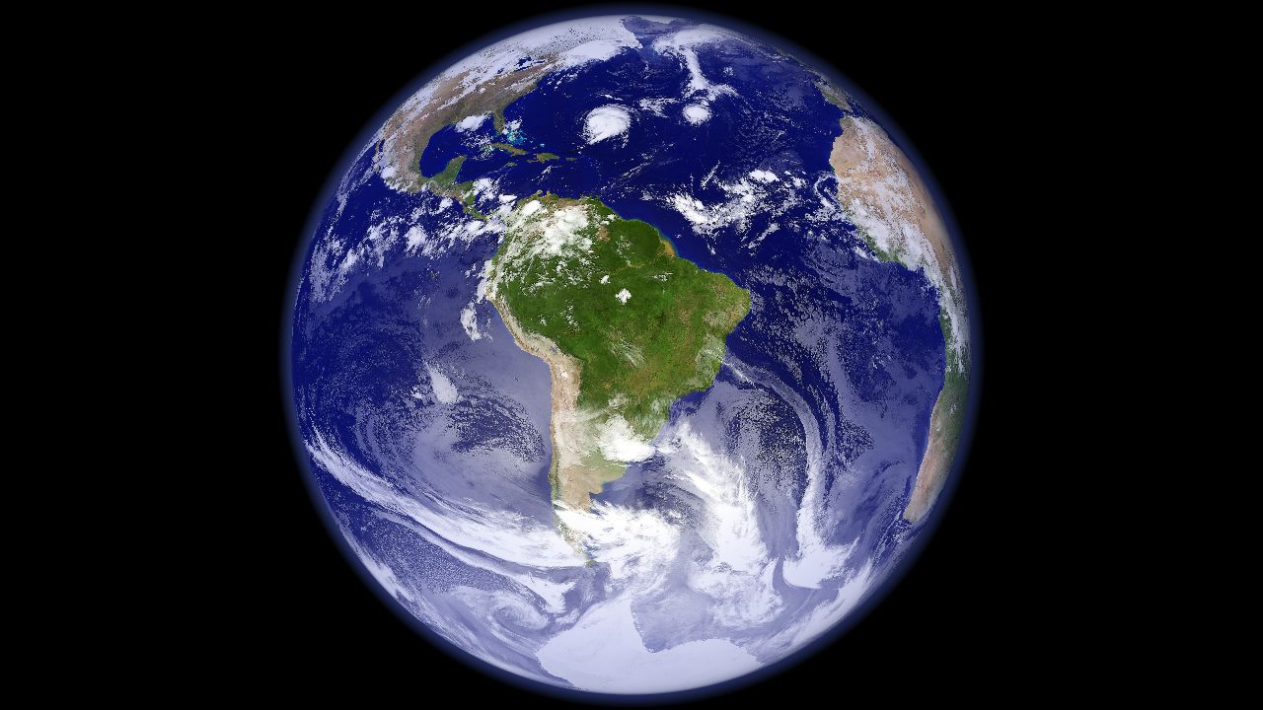

Slide 4
What is Sustainable Energy?
Sustainable
  capable of being supported or upheld
  a system that maintains its own viability by using techniques that allow for continual reuse
Energy
  Power to do work that produces light, heat, or motion
  The capacity for activity; available power

Slide 5
What Does Home Building Have to do With Sustainable Energy?
Homes consume about 20% of energy in the US
2/3 of electricity in the US comes from burning coal or natural gas
Homes are not created equally
Home owners don’t use energy equally

Slide 6
Net-Zero
Does anyone know what a Net-Zero home is?
  A home that produces as much energy as it consumes
California is requiring that all new homes built after 2020 are net-zero

Slide 7
What Does a Builder do to Produce a Net-Zero Home?
Build homes that are more energy efficient (use less energy)
Build homes that generate their own energy
Usually some combination of the two
Were going to talk about three things specifically

Slide 8
What Does a Builder do to Produce a Net-Zero Home?
Geothermal heat pumps
Photovoltaic
  Solar panels
Wind turbines

Slide 9
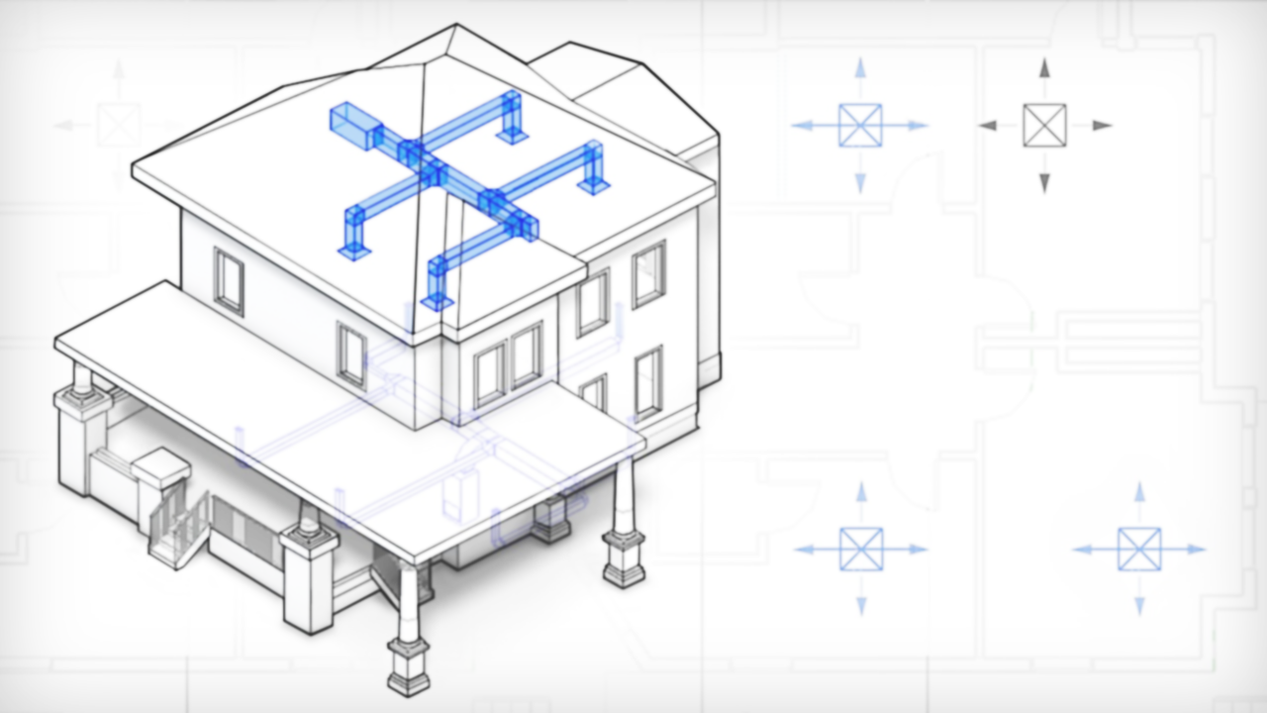
Energy Beneath Our Feet!
Geothermal Heat Pump- Draws heat from beneath the ground and uses it to make heating and cooling easier
Below 20’ the earth maintains a 50-60 degree temperature

Slide 10
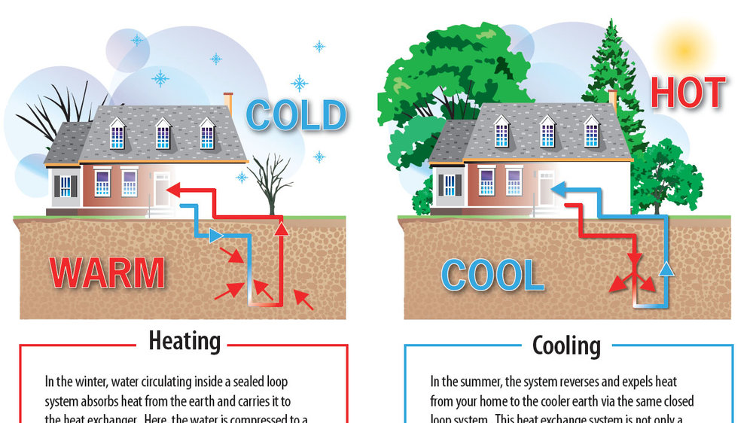
WINTER
SUMMER
An underground loop system and the constant temperature of the earth combine to create a comfortable climate in the home

Slide 11
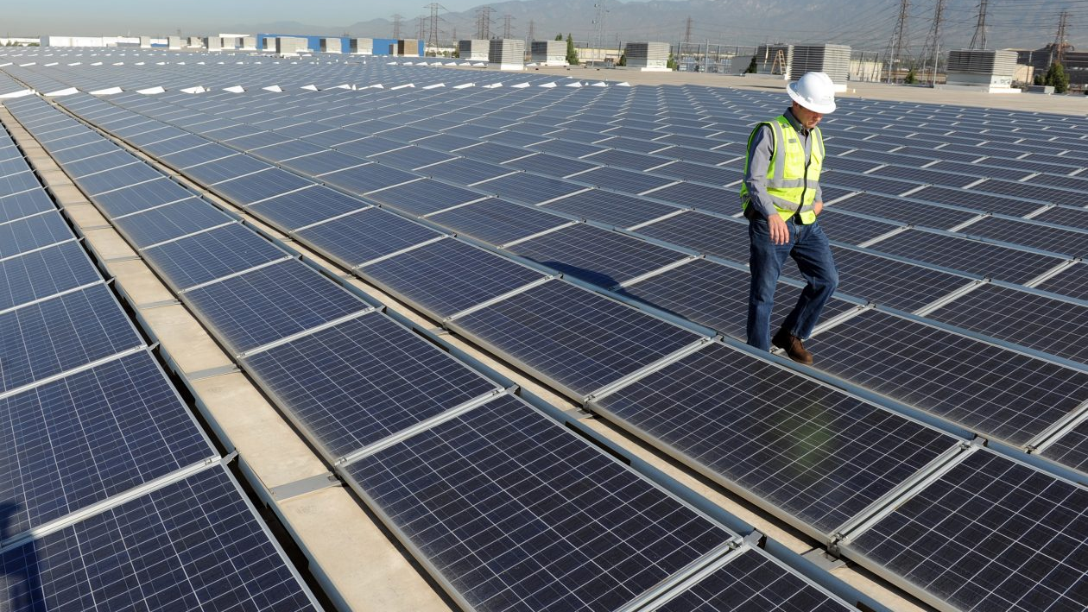
Energy Above Us Too!
Solar Energy- A type of energy created by the sun.
Photovoltaic (PV)- the production of electric current at the junction of two substances exposed to light.
Solar Panels- Panels where PV occurs as the sun’s rays hit them.

Slide 12
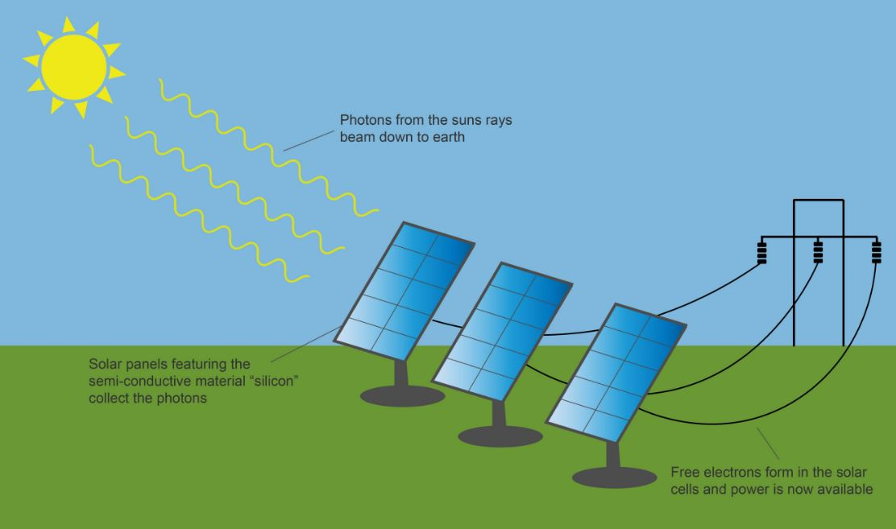
1.) Solar energy radiates down to earth
2.) Photovoltaic cells absorb the solar energy and turn it into electricity.
3.) The electricity is then converted from DC to AC and is ready to be used in your home.

Slide 13
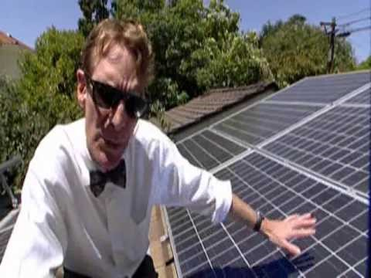
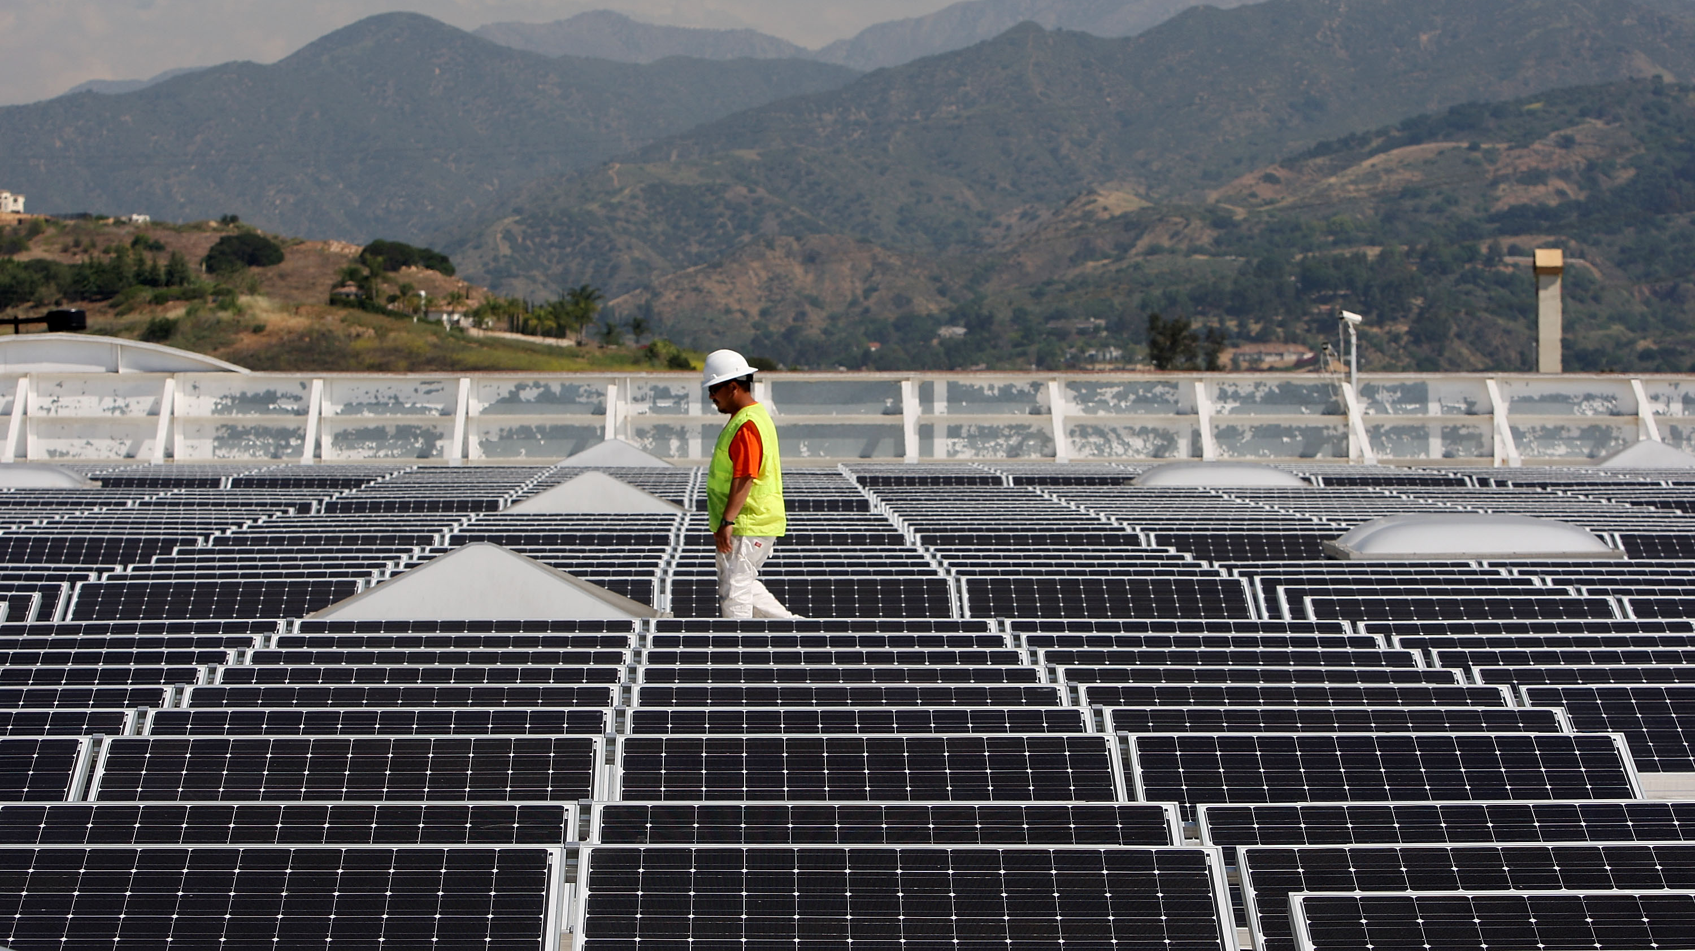

Slide 14
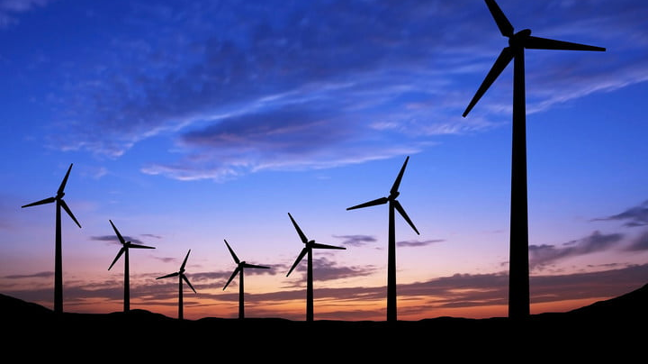
Energy is Blowing Past Us!
Wind- Created by the unequal heating of Earth’s surface by the sun
Wind Turbine- A device that is driven by the wind that produces electricity

Slide 15
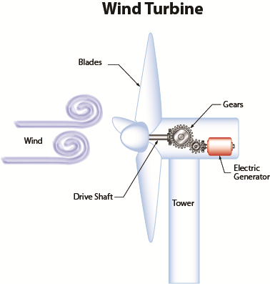

Slide 16
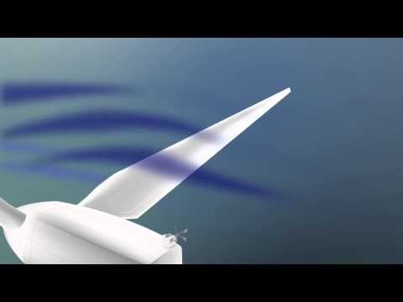
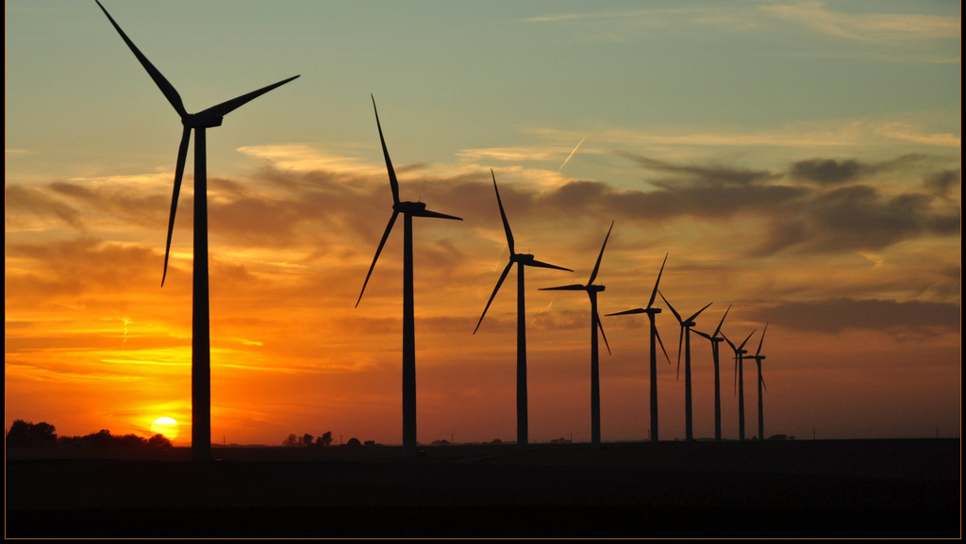
https://youtu.be/tsZITSeQFR0

Slide 17
Lets Build Our Own!
Groups of 3-4
Each group send one member to the front to collect materials
Wait for directions

Slide 18
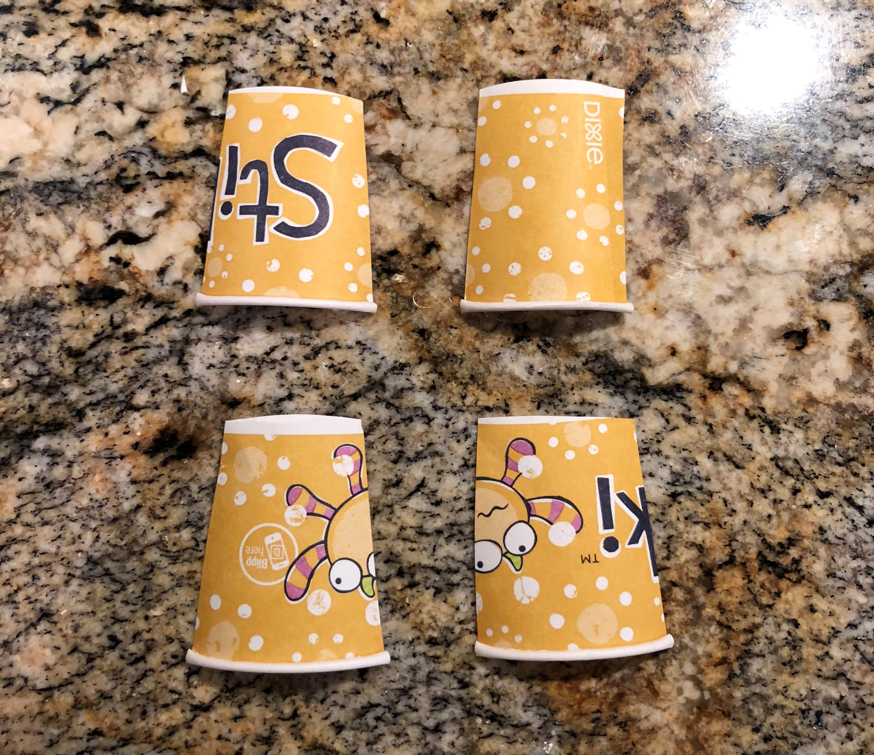
Take the SMALLER cup
Using your scissors, cut the smaller cup into 4 equal parts from the top down

Slide 19
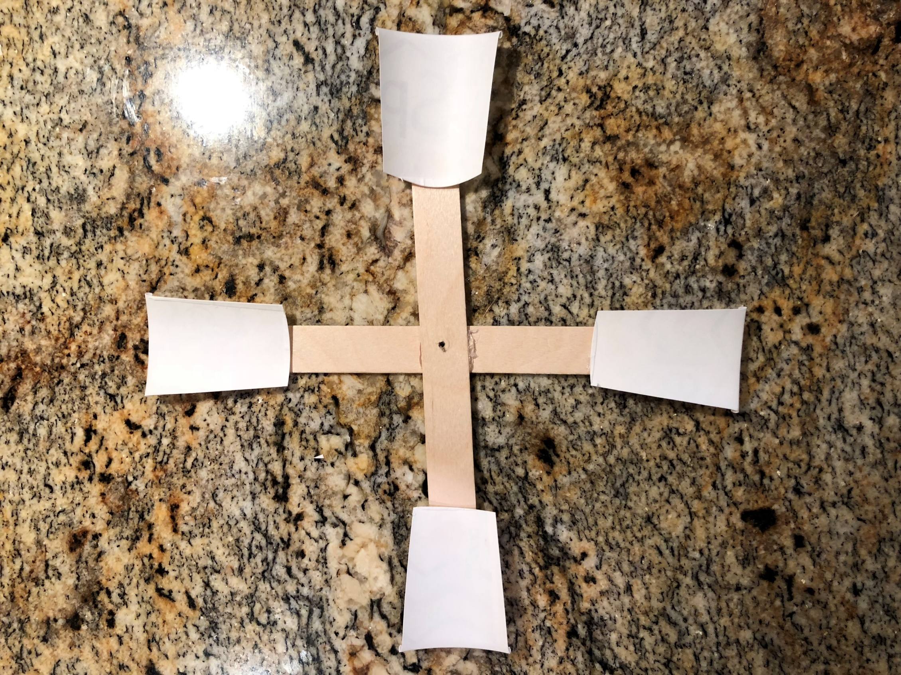
Using the hot glue gun, place a little dot on the end of your cross popsicle sticks.
Once your dot is in place, apply one of the pieces of the cup you just cut.
Make sure you apply it with the INSIDE of the cup facing forward.
Do the same for the other three pieces.

Slide 20
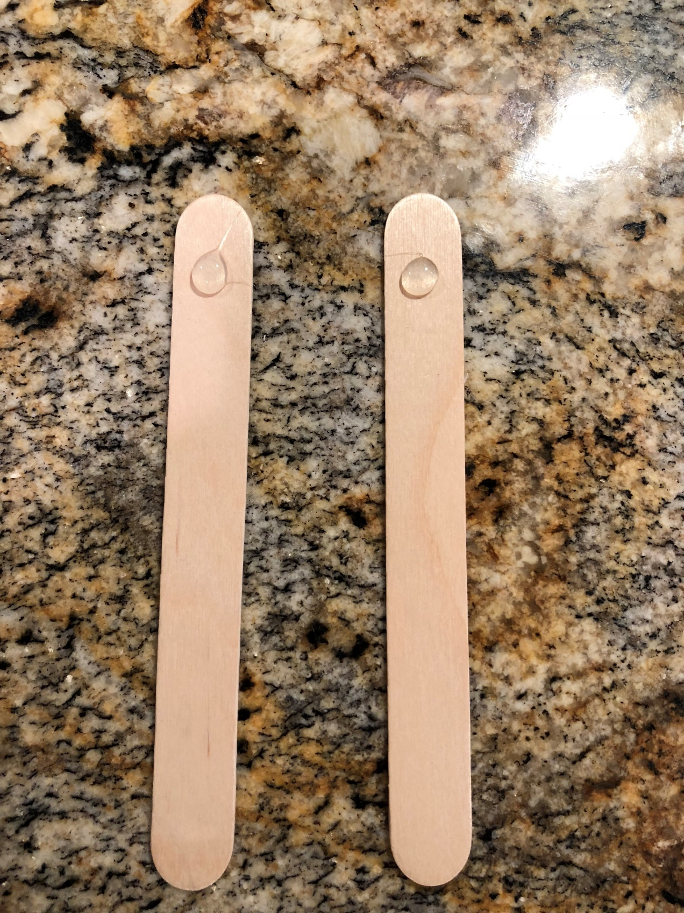
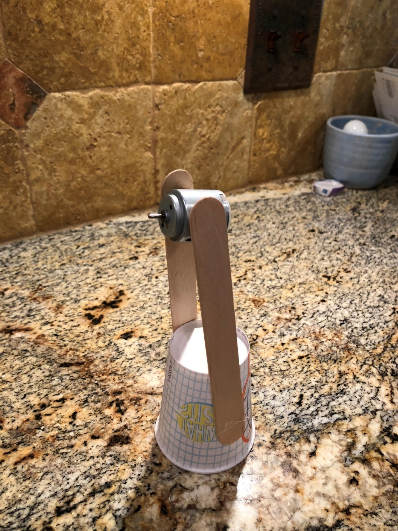
Take your larger cup and place the end you drink from down on the counter.
Taking your other two popsicle sticks, apply a glue at the end of the stick.
Once you have your glue applied, place your popsicle sticks on both sides of your cup so that they are opposite from one another.

Slide 21
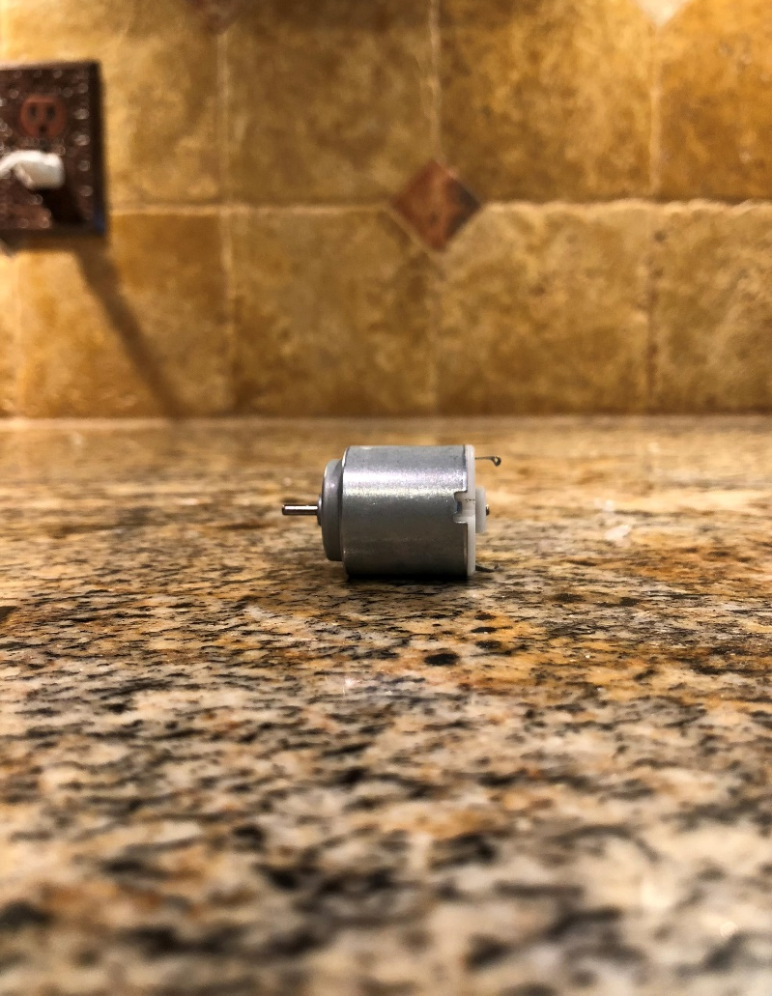
Once you have both of your popsicle sticks attached to your cup vertically, apply another dot of glue to the inside top of both.
From there, attach your motor and make sure that it is at an angle facing UP.

Slide 22
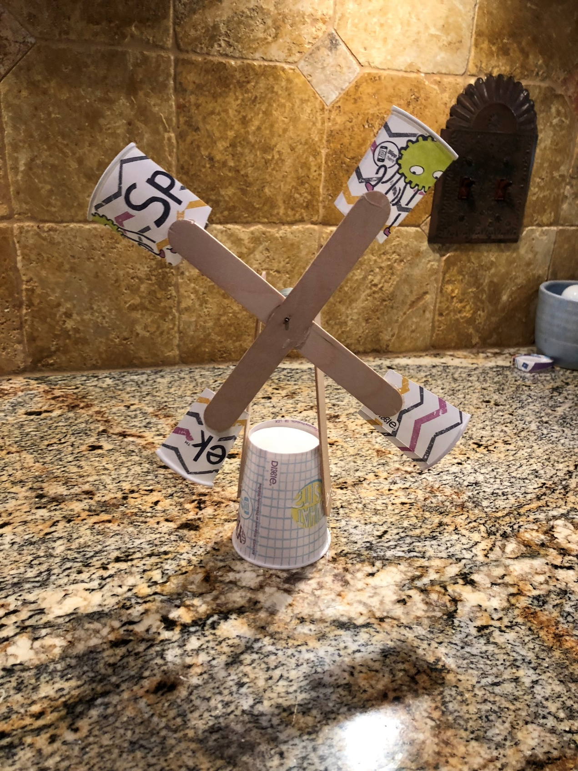
Finally, attach your wind blade to the shaft sticking out of the motor.
Make sure that the outside part of the cup is facing OUTWARDS.
Let’s test them out!

Slide 23
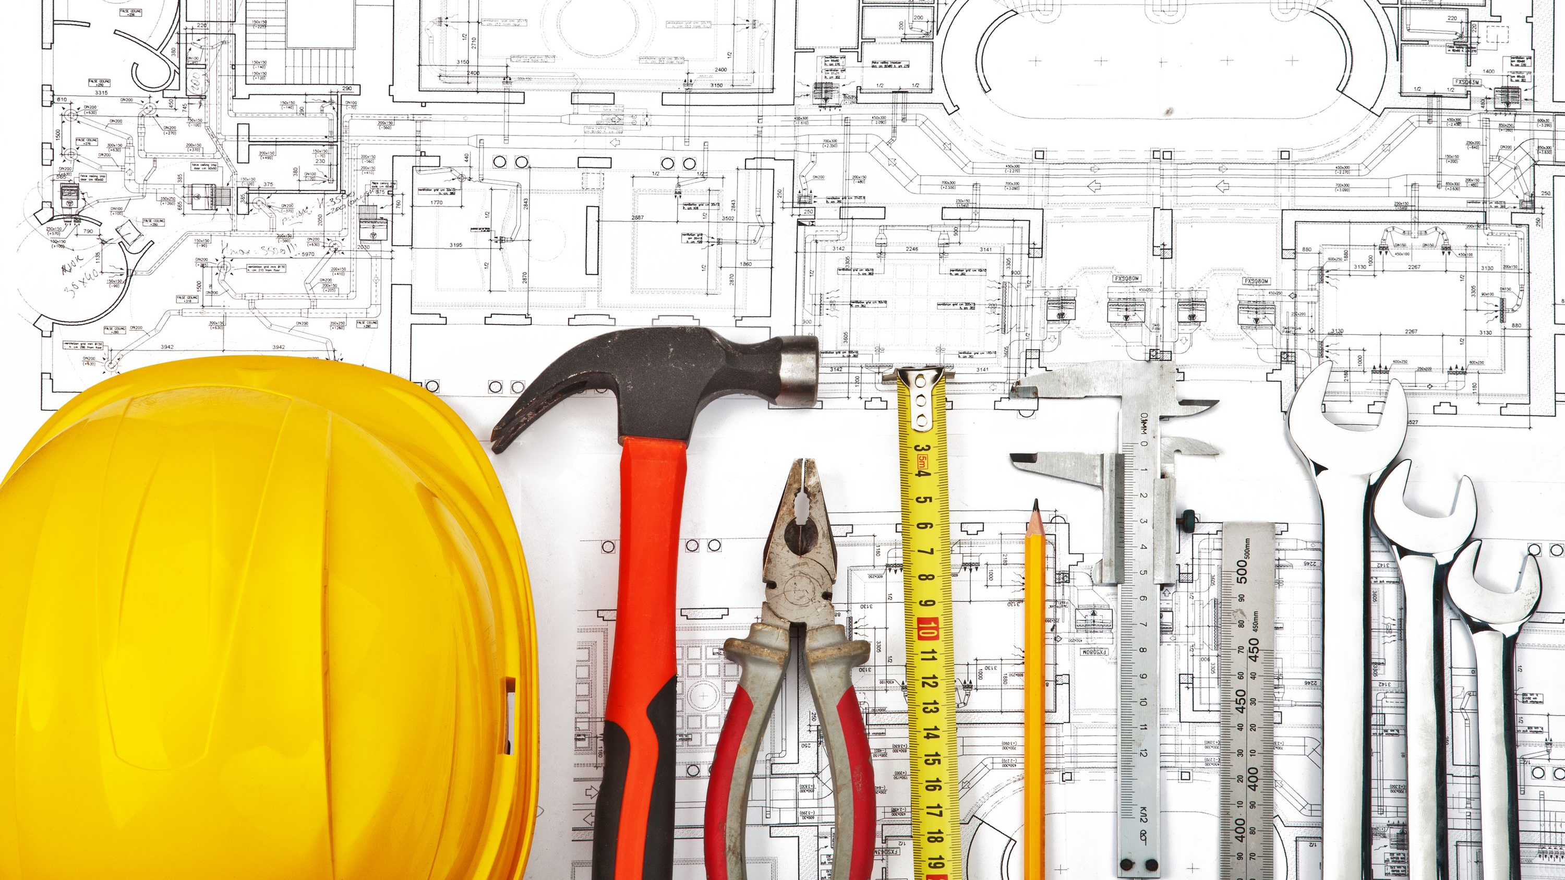
Sustainable Building
Why do you think all homes are not built to be Net-Zero?
What did you learn today?
Builders get to learn about these things and make them a reality for your family!

